Slide 1

CookBook Food Recipe App
CPAD Project
Priti Giramkar: 2022SP93016
Monika Agrawal: 2022SP93054
Raghav Dayal: 2022SP93064

Slide 2
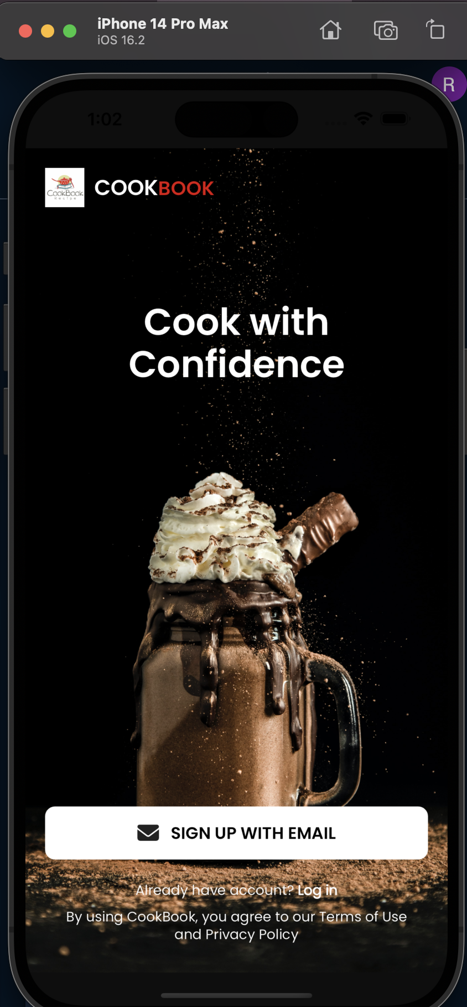
About Project:
our project is like Instagram but for foodies! Here, you can sign up and log in to see your uploaded recipes in one place, and just like Instagram, people can like, comment, and share your yummy creations. Explore various recipes sorted by categories, search for specific ones, and save your favorites for later. But Cookbook isn't just about recipes – you can also make grocery lists, like and reply to comments, find and chat with other users, and much more. Whether you're a pro chef or just love cooking, Cookbook is the perfect place to share, discover, and enjoy the world of food together!

Slide 3
Features
• Exploring different types of recipes and categories. • Searching for specific recipes. • Bookmarking your favorite recipes. • Ability to Post, and Comment on what other people have shared. • A list for saving ingredients while going to grocery store. • Like and reply to comments. • Search for specific users and view their profile. • Send messages to other users and add them to your chat list.

Slide 4
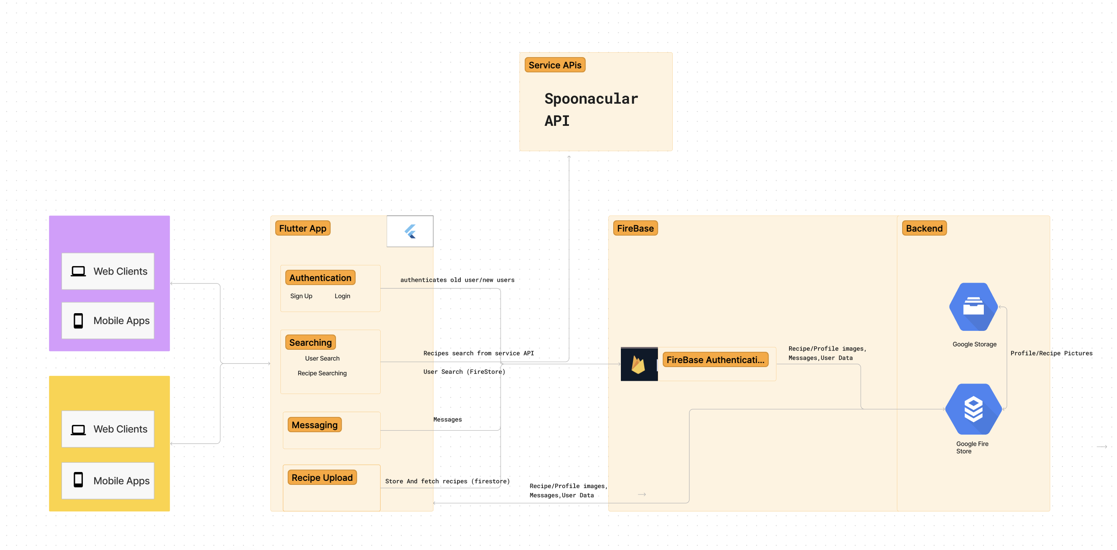
Architecture:

Slide 5
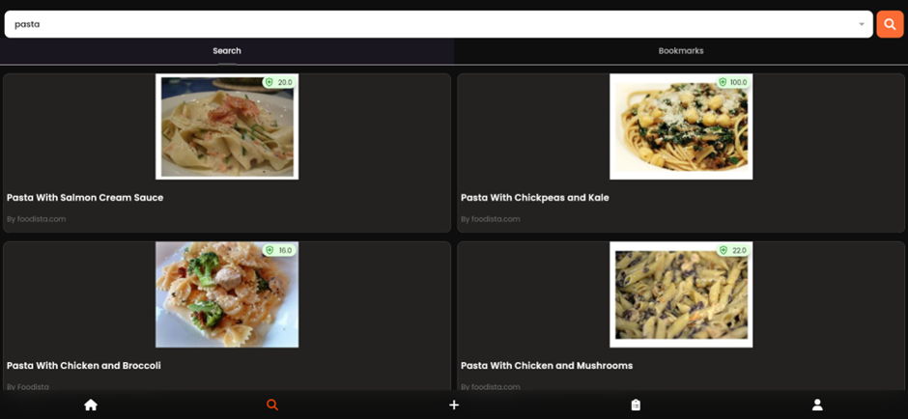
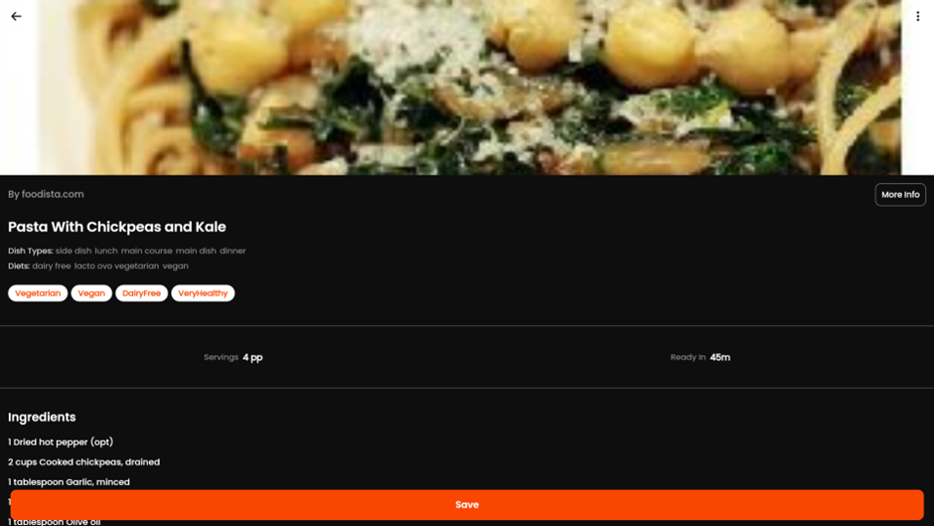
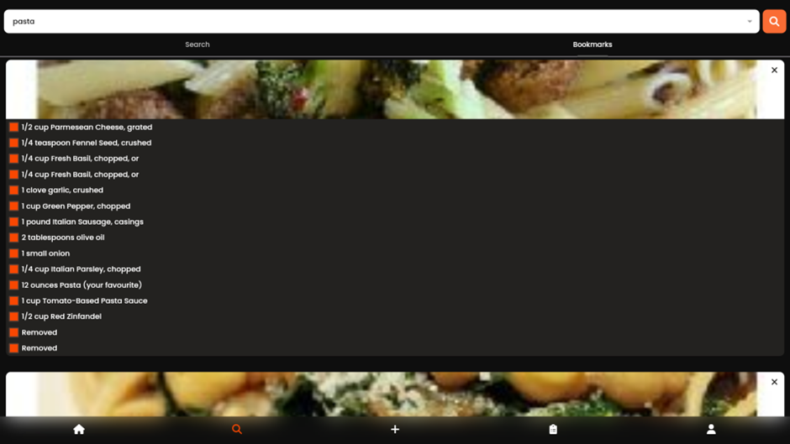
Screen-shots WEB:

Slide 6
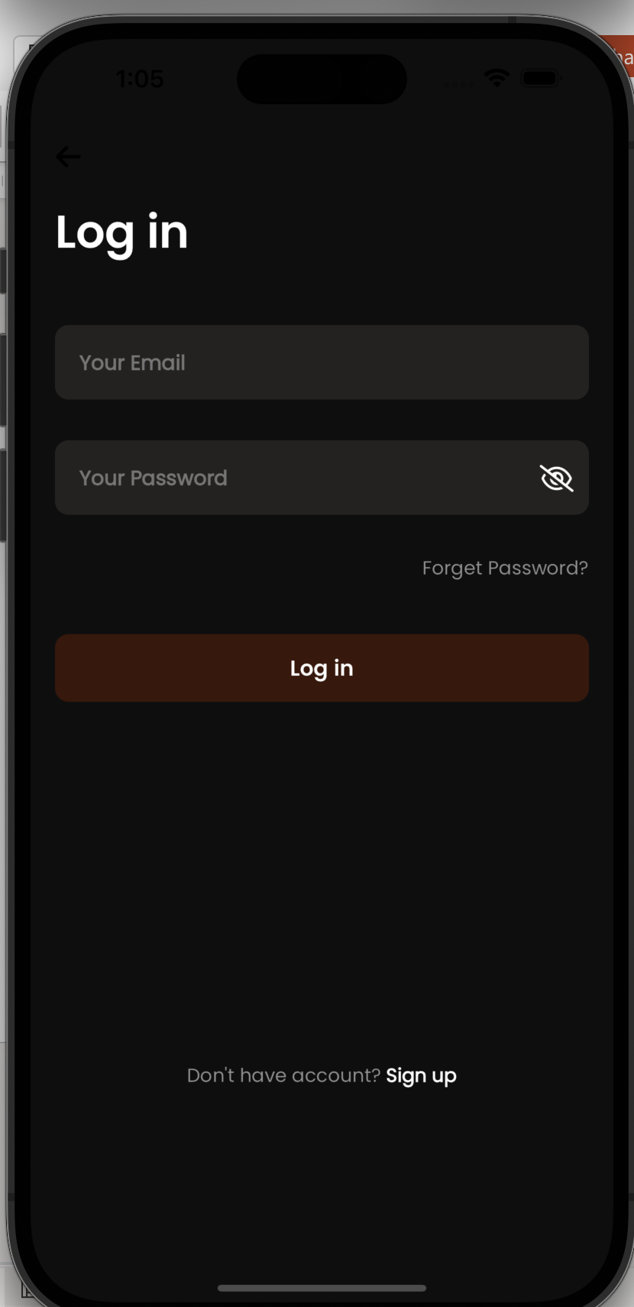
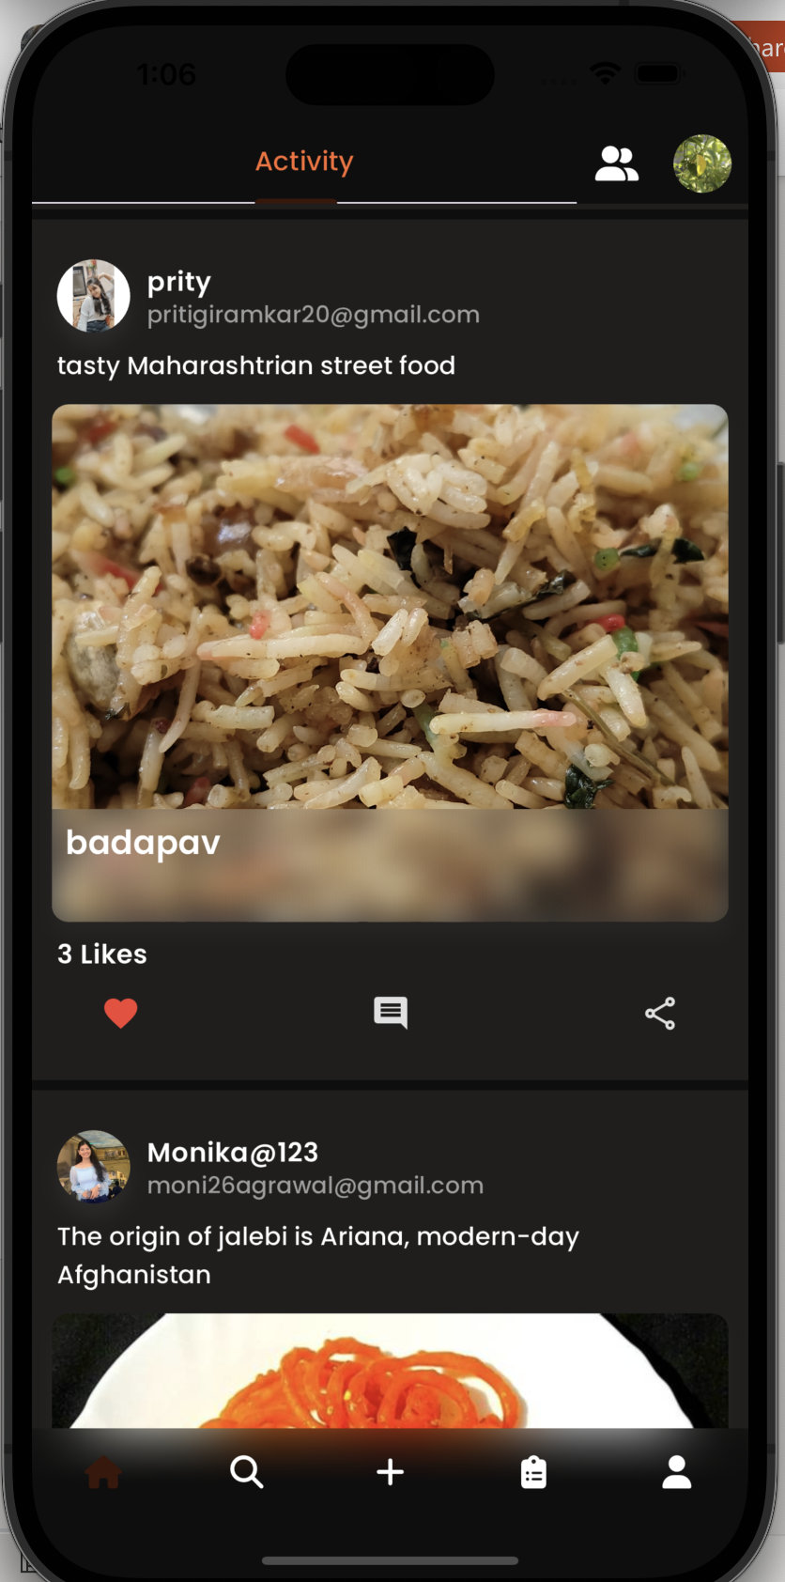
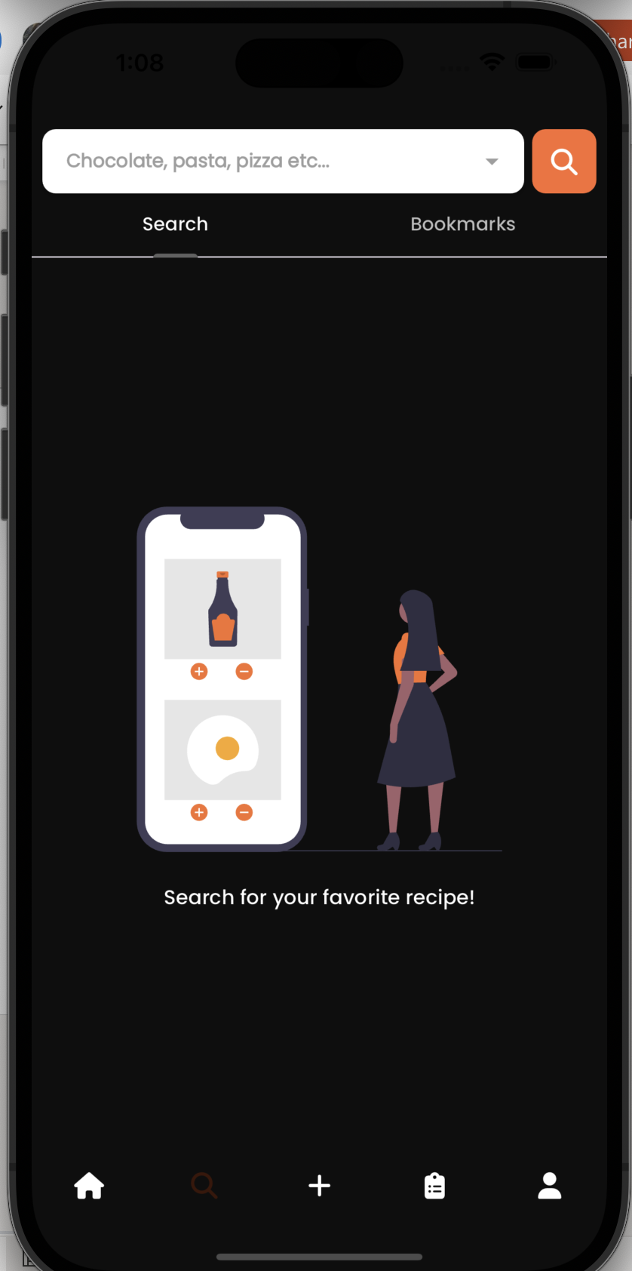
Screen-shots IOS:

Slide 7
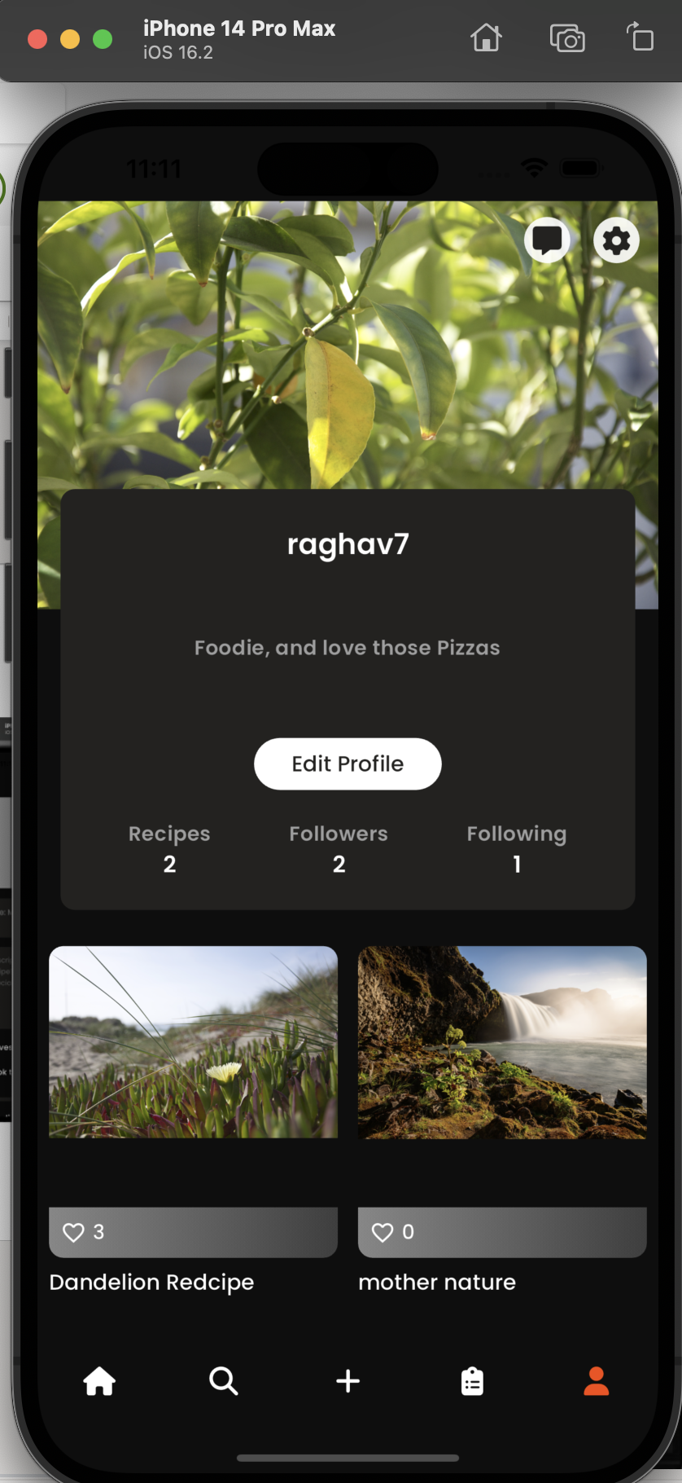
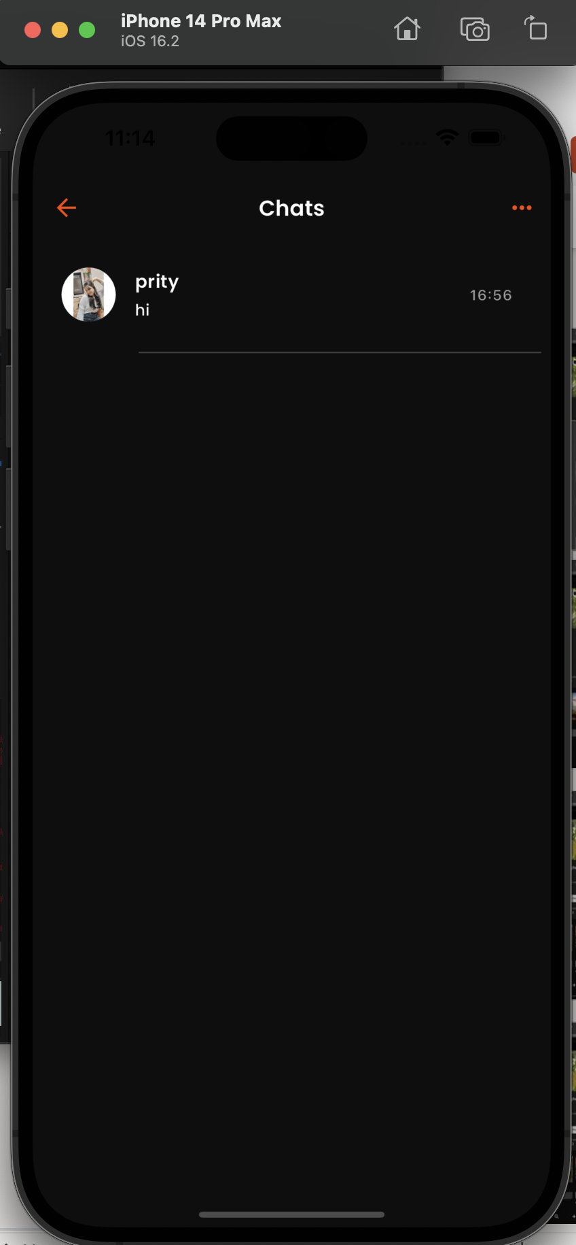
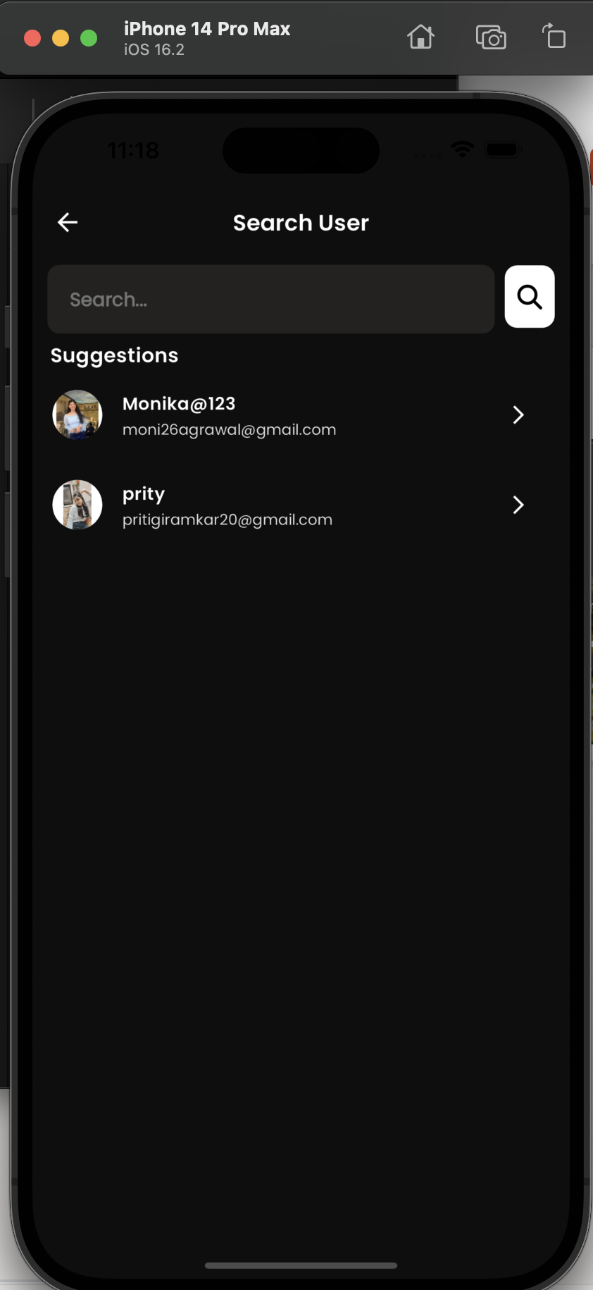

Slide 8
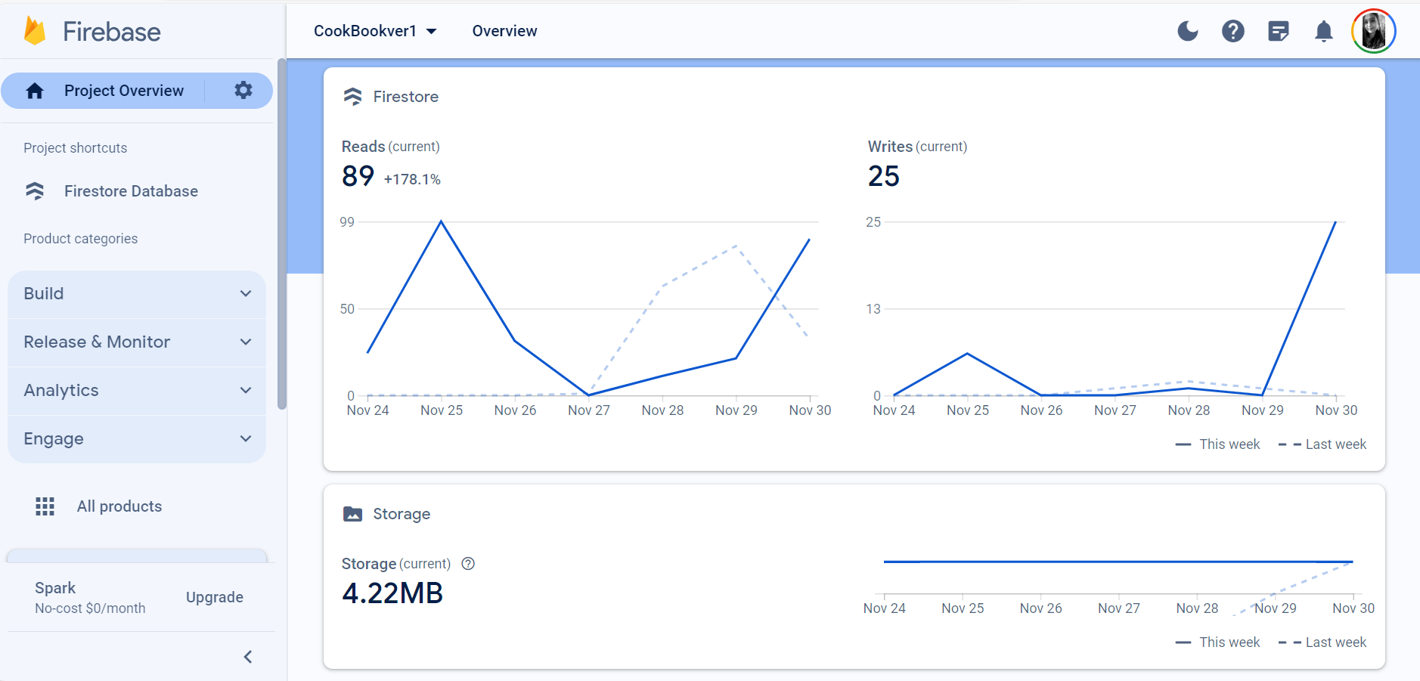
Firebase Data

Slide 9
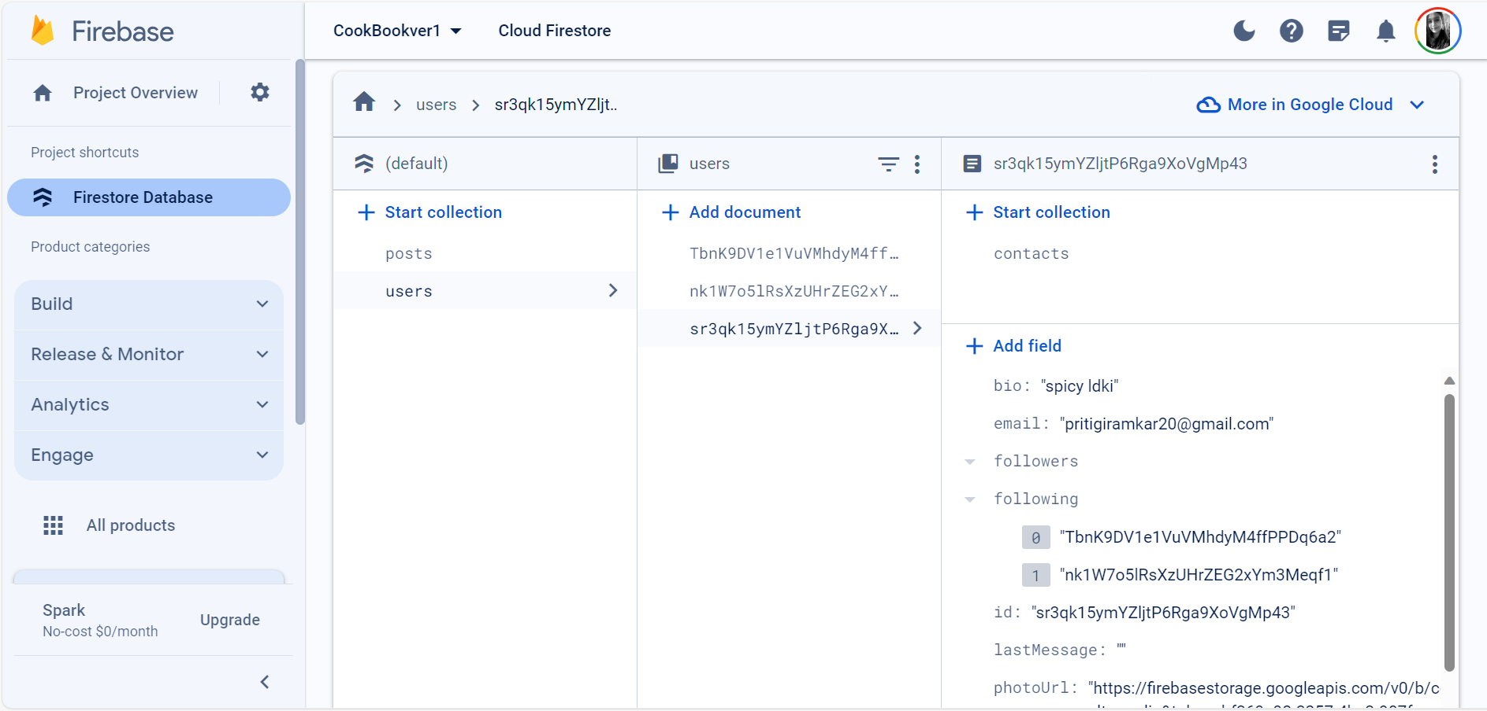
Firestore Database

Slide 10
challenges and interesting points:
1. Real-Time Collaboration on Recipes
2. User Engagment
3. Advanced Search
5. Messaging
6. Integration with spoonacular APIs

